Slide 1
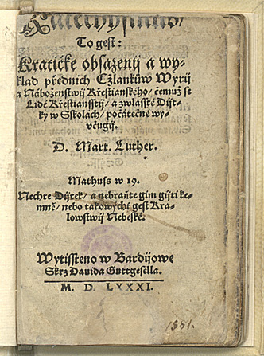
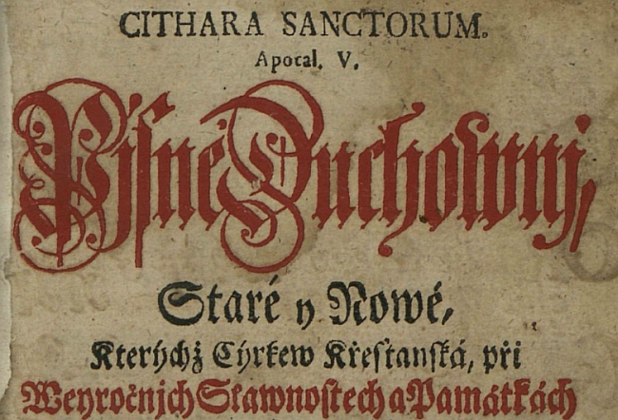
Invention, Transfer, and Reception: the Making of the European Reformation(s) A Methodological Survey of Reformation Historiography Budapest, June 4, 2019
Problems with the “Slovak Reformation”
I. The process of adopting the ideas of the Reformation
language question

Slide 2
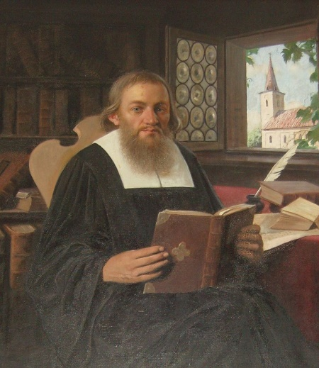
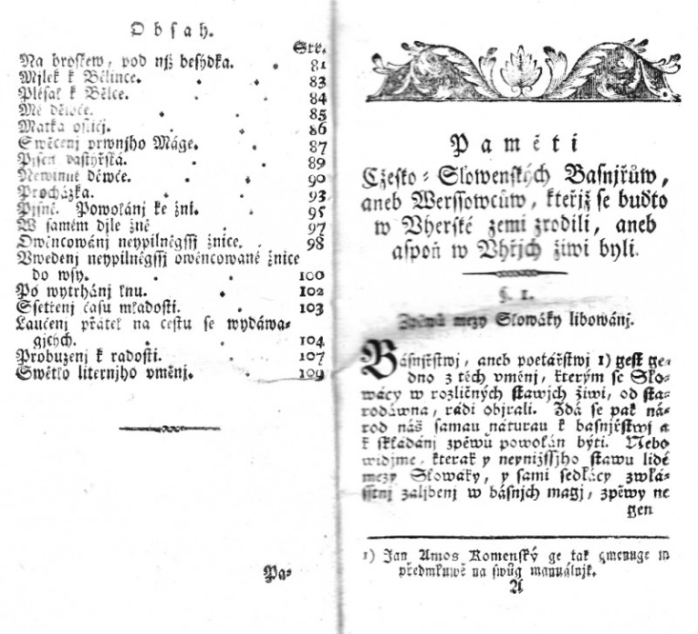
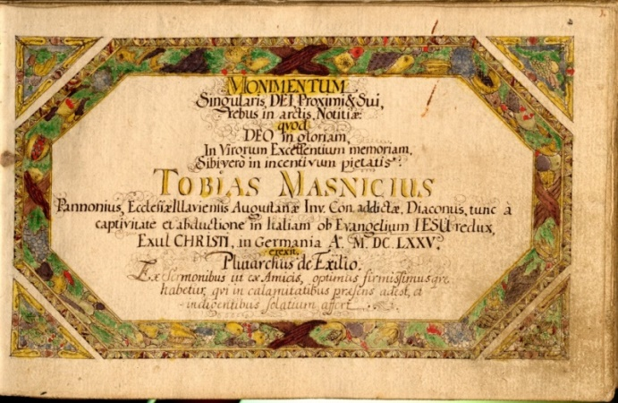
II. Diversities in language and history
-Thobias Masnicius(1670-1697)
-Daniel Krman jn.(1663-1740)
-Bohuslav Tablic (1769-1832): „Slovaks = true protectors of Reformation in Hungary“, argument repeated in discussions concerning Union (J.M.Hurban)

Slide 3
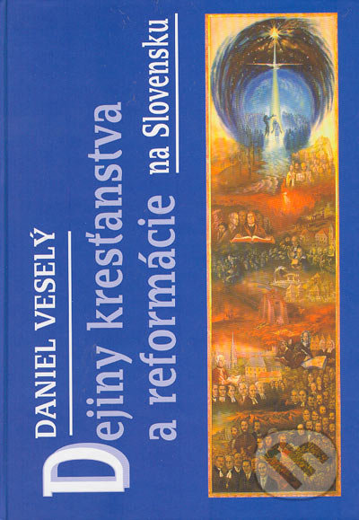
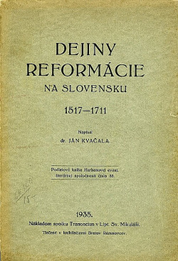
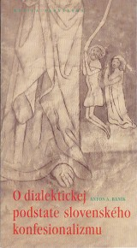
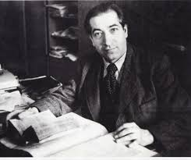
III. Historiography
Modern / current historiography
-studies on acteurs of Reformation (Stoeckel!)
-secular historiography – development of
literature (dominant in research)
-Reformation as a part of national narrative =
concept still present
-effects of Reformation tudied - but few from perspective of new concepts
-research concerning the theology almost cpmpletely missing
Anton Baník

