Slide 1
The Nordic Reformations: A comparative Approach
Budapest, 04.06.2019
Tarald Rasmussen, University of Oslo

Slide 2
The Nordic Region in Late Middle Ages

Slide 3
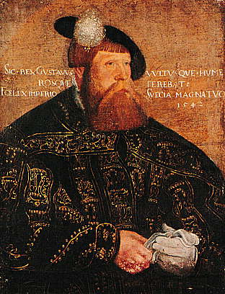
Gustav Vasa of Sweden, 1542
(1496 – 1560)

Slide 4
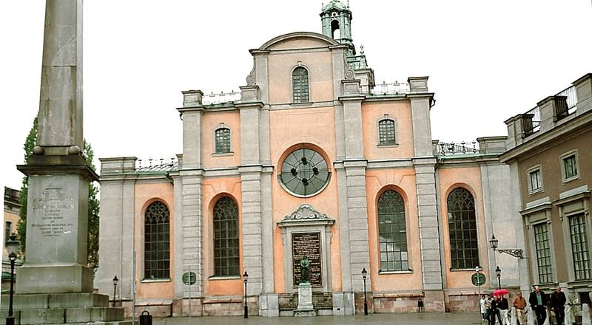
Storkyrkan, Stockholm

Slide 5
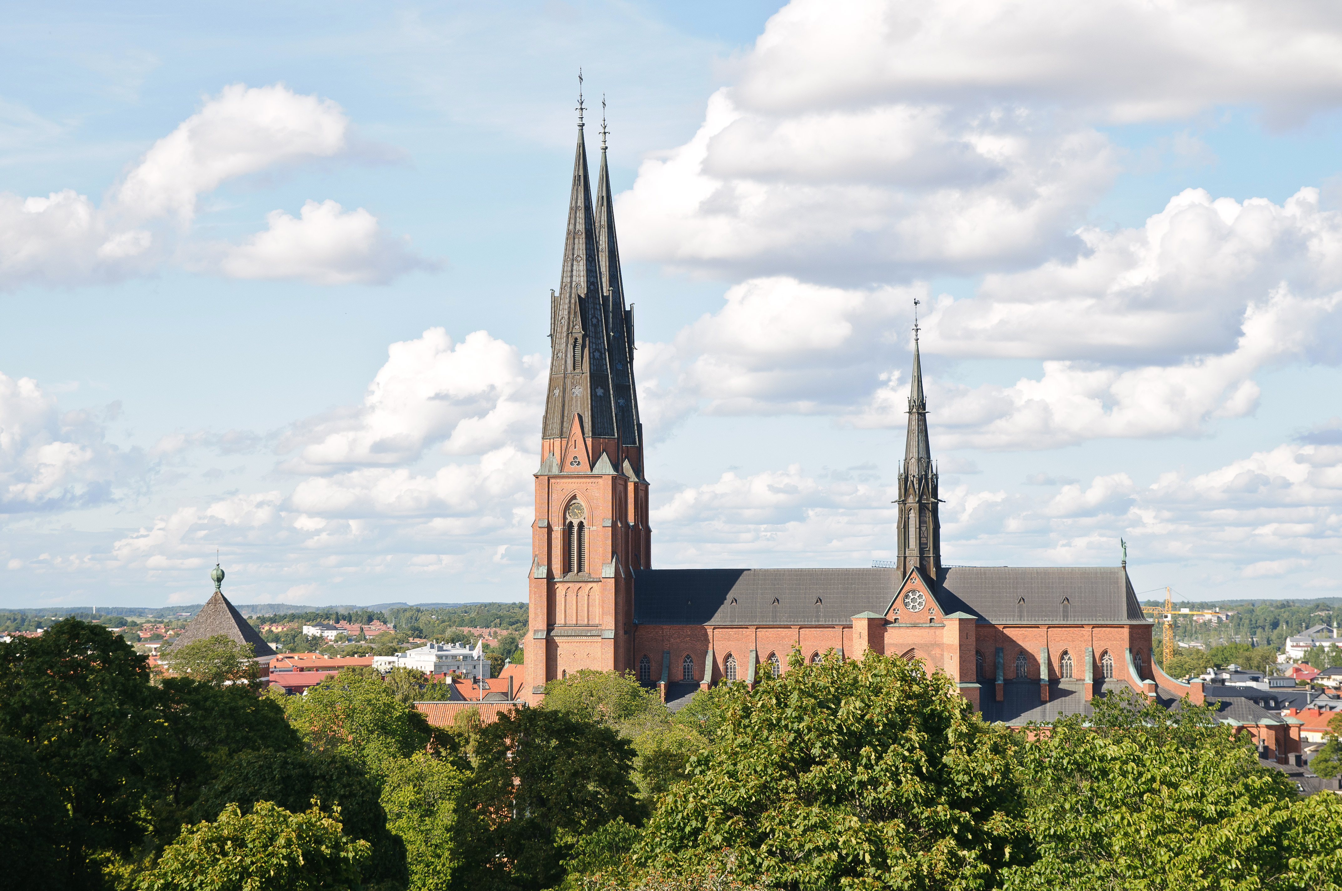
The New Cathedral of Uppsala

Slide 6
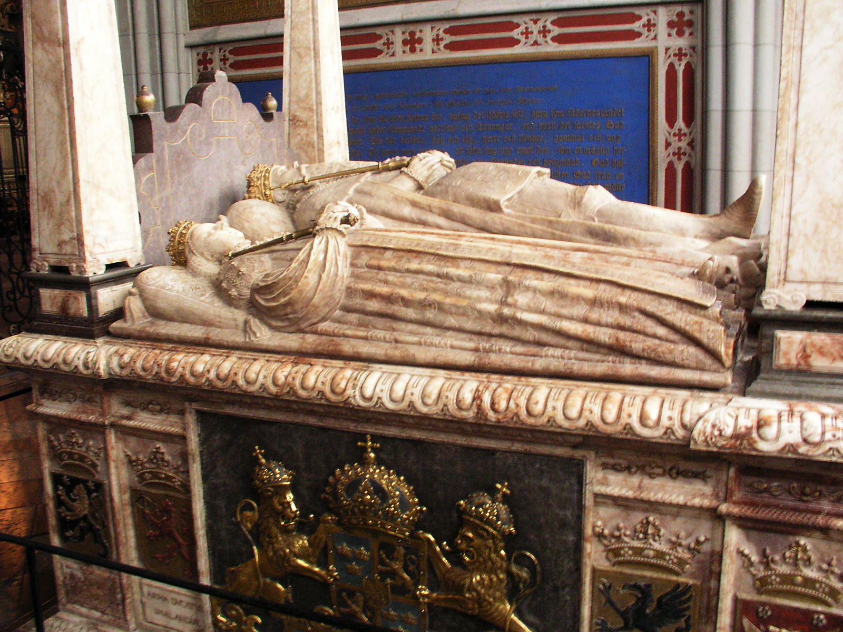
Gustav Vasa´s Funeral monument

Slide 7
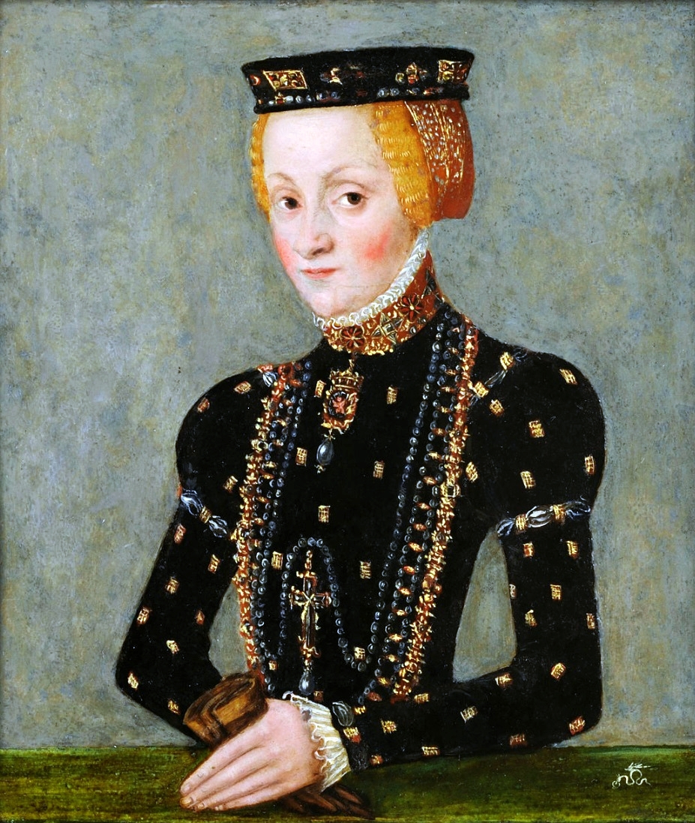
Katarina Jagellonica
(1526–1583)

Slide 8
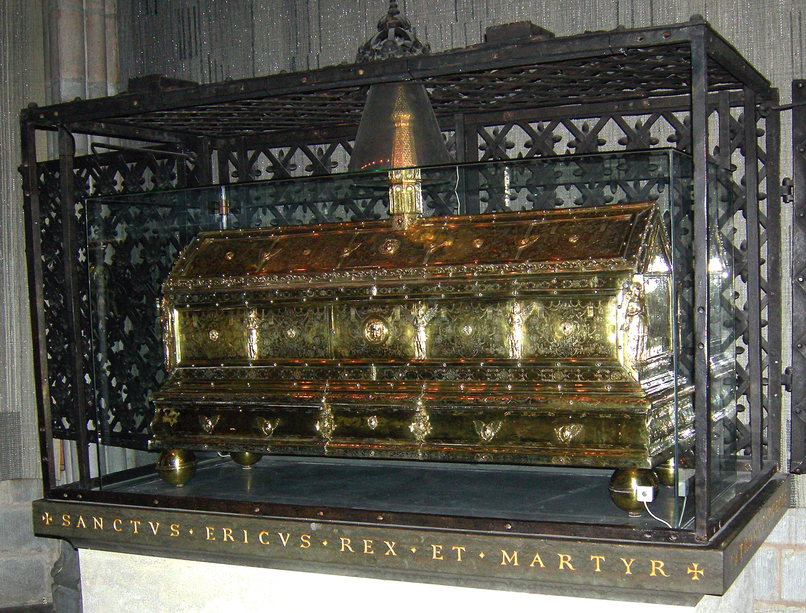
Erik´s Reliquary, Uppsala

Slide 9
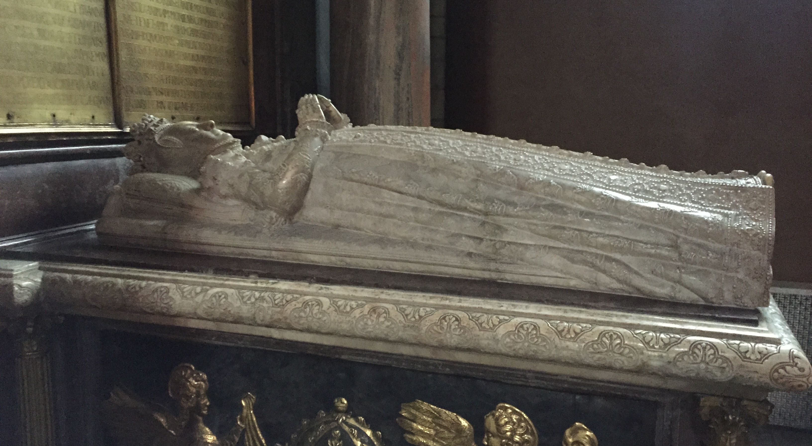
Katerina Jagellonica, Uppsala

Slide 10
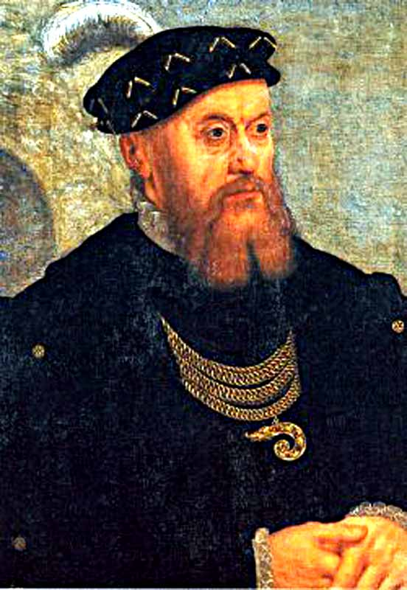
Christian III of Denmark & Norway
(1503 – 1559)

Slide 11
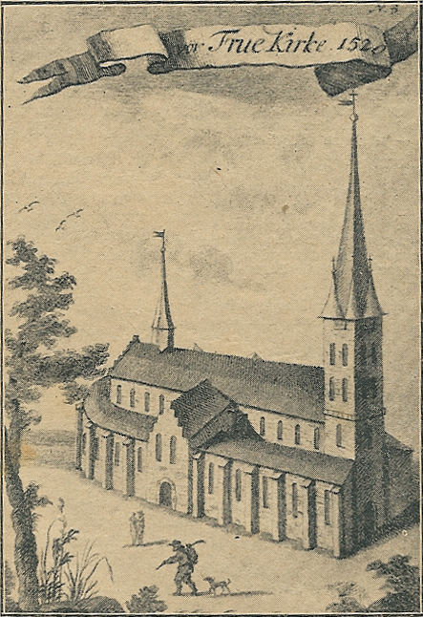
Vor Frue Kirke, København, 1520
(Kollegiatskirke to Roskilde Cathedral)

Slide 12
1. Fürstenreformationen:
Common: Lutheran hereditary dynasties, established with the reformation. Lutheranism as legal part of Testament by introduction of monogeniture.
(Less impact of “Stadtreformation” than in many parts of Germany: still more important in Denmark (Malmø, Viborg) than in Sweden.)
Sweden: Dynastic profile from Gustav Vasa changed with Johan III. Church institution remained strong partner.
Denmark: Loyalty to regulations of reformation king Christian III. Church institution included as part of royal administration. Church as institution abolished.

Slide 13
2. European dynastic networks:
Common: Both dynasties connected to European networks.
In the 16th century: Denmark closer than Sweden.
Sweden: Vasa-family, linked to the influential East-European Catholic, but confessionally quite tolerant Jagellonica-dynasty with the marriage of John III. (European dynasty until 1572.)
Denmark: linked by several marriages primarily to German dynasties. Most important: Anna, daughter of the reformation king, married to the strict Lutheran Elector of Saxony.

Slide 14
3. Networks of Learning:
Common: Both countries: Initially (1520ies) strongly influenced from Wittenberg. Early Protestant Elite who had studied there.
Sweden: Uppsala university (founded in 1477) mostly inactive and of little importance until after 1593. Instead: Rostock (and Wittenberg). Melanchthon through Chytraeus.
Denmark: Close contacts with Wittenberg lasted longer, and were already since the 1530ies gradually replaced by the renewed Lutheran university of Copenhagen (founded 1479, reformed immediately after the reformation): a new stronghold of Protestant Learning. Melanchthon through Hemmingsen.

Slide 15
4. Networks of trade and craftsmanship
Common:
Early 16th century: Hanseatic League crucial. Especially Lübeck important to both countries.
Later 16th century: Increasing influence from the Low Countries, in trade as well as in craftsmanship. (Confessional challenge, especially to Denmark: “Fremmedartiklene” 1569) Cf. in Denmark: tombs of Christian III in Roskilde and of Herluf Trolle, Herlufsholm: both made by Cornelis Floris, Antwerpen. In Sweden: tombs of Gustav Vasa, Katharina Jagellonica & al. by Willem Boy, Mechelen.

Slide 16
5. Nation and Confession:
Common: Reformation starting point of national & dynastic growth. Both countries as important European Early Modern Lutheran powers: first Denmark, then Sweden (30-years-war).
Sweden: New national identity rooted both in a) Medieval Traditions (Uppsala, St. Erik) and in b) Reformation ideology (new start, supporting the new role of the King as the Leader of the Church).
Denmark: Closer mutual connection between national and Lutheran confessional identity. Medieval roots less important for legitimizing new Protestant dynasty.

Slide 17
6. Topography and Memory:
Common: Sweden & Denmark: No deconstruction of Medieval Holy places in order to prepare for New Confession (Like in Norway/Nidaros). Relics kept in Vadstena.
Sweden: Like in Medieval times with Old Uppsala and Uppsala closely connected: now with the Reformation Uppsala and Stockholm closely connected. Stockholm as new center of Protestant dynasty dependent on Uppsala traditions.
Denmark: Copenhagen as new center of Protestant dynasty on its own. Important elements: University (Wittenberg model) and “Vor Frue”: new central church. No similar connections to the old archbishopric in Lund or to the bishopric and royal burial church in Roskilde. Bishop of Sjælland resided in Copenhagen.

