Slide 1
László Drótos (NSZL Web Archiving Department) From Seed to Blossom The Hungarian Web Archiving Project
‘404 Not Found – Who will preserve the Internet?’
Video conference and workshop – 2021
National Széchényi Library Budapest, 23–24 November 2021

Slide 2
Born-digital archiving at the National Széchényi Library
1999 – Hungarian Electronic Library (dating back to 1995)
2003 – Electronic Periodicals Archive & Database
2007 – Digital Picture Archive
2006 – Hungarian Internet Archive (proposal and first tests)
2017 – National Web Archive
2017-2018 – pilot period
since 2019 – normal operation
2020-2021 – legal framework
2

Slide 3
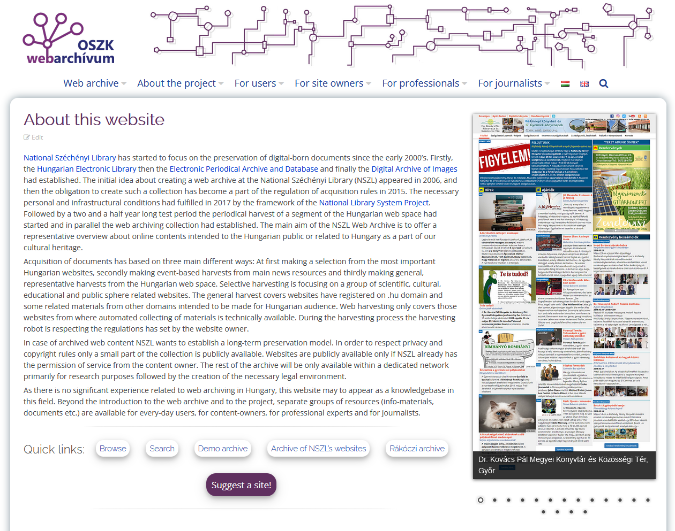
since 2020: a Web Archiving Department with three full-time staff members and one part-time IT developer & system administrator
Homepage: webarchivum.oszk.hu
3

Slide 4
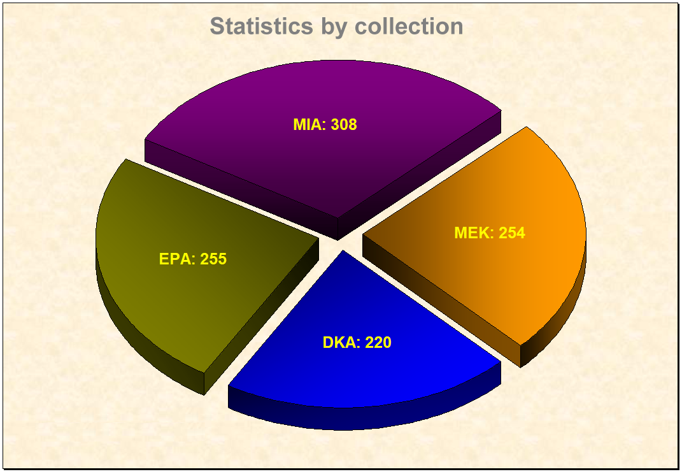
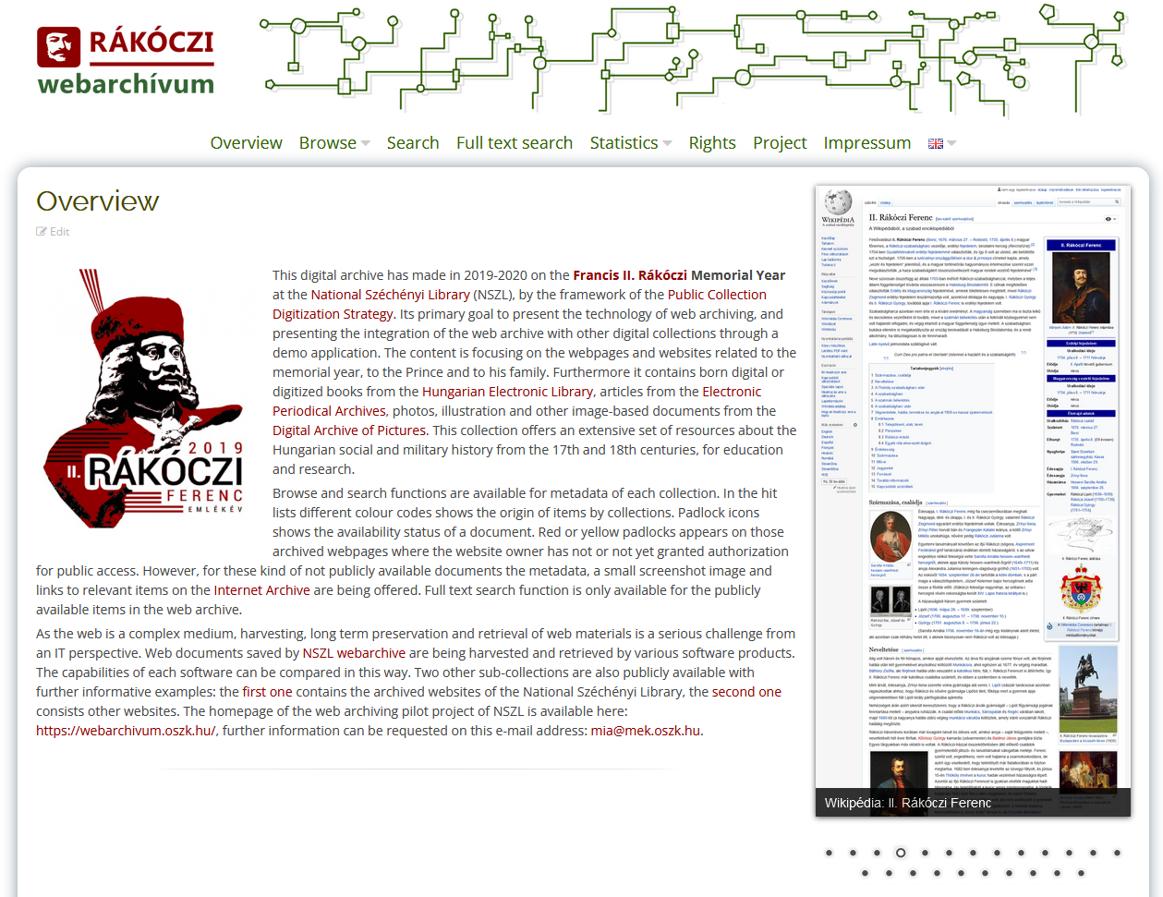
an example of integrated
digital collections, developed as part of the Public Collection Digiti- zation Strategy in 2019-2020
Rákóczi archive: rakoczi2019.webarchivum.oszk.hu
4

Slide 5
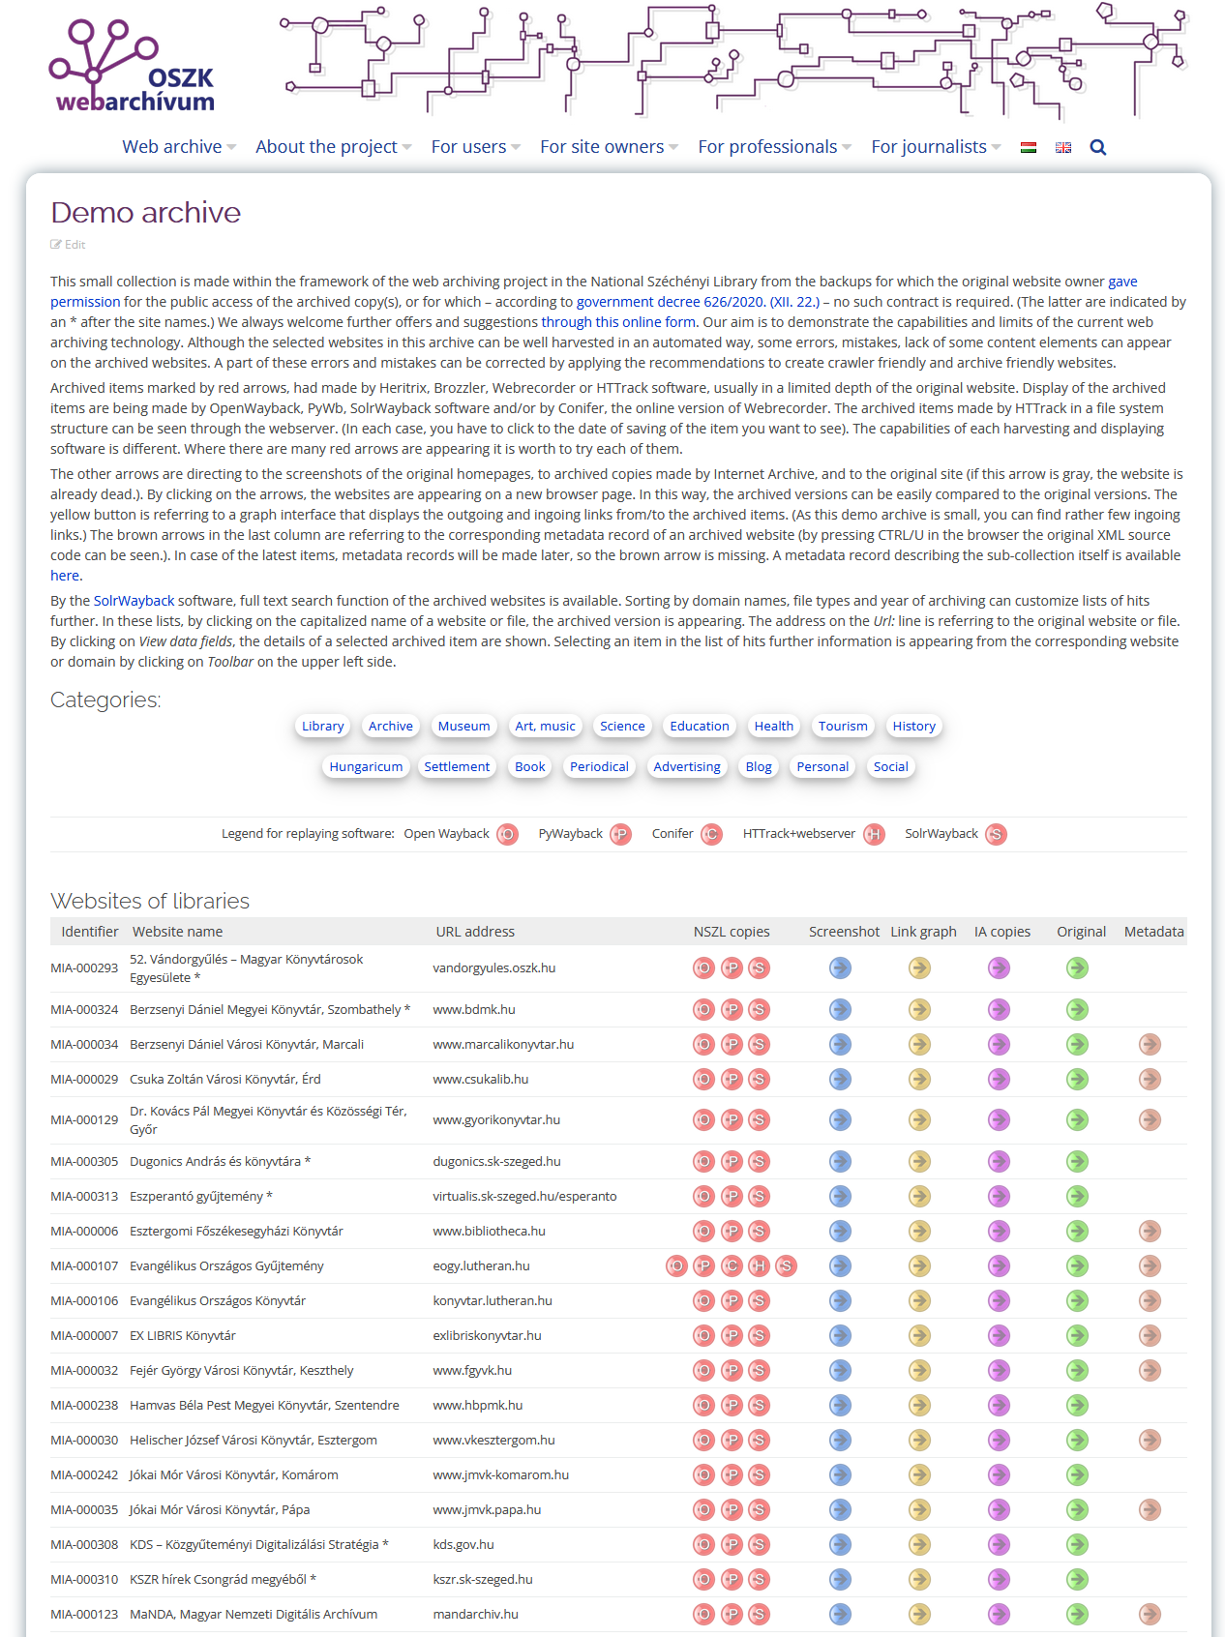
Public web archive:
webarchivum.oszk.hu/demo-archive
Playback tools:
OpenWayback
PyWb
SolrWayback
webserver (HTTrack file system)
Conifer
5

Slide 6
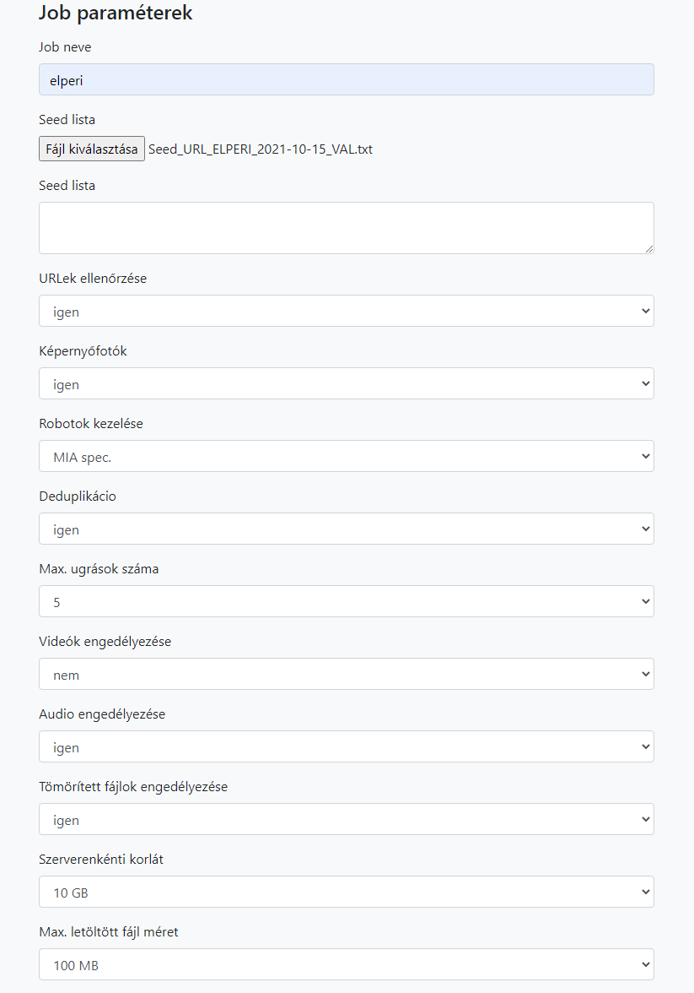
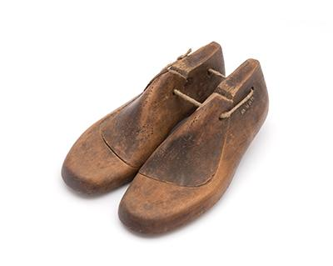
Archiving tools:
Web Curator Tool
Kaptafa (in-house developed)
Heritrix
Brozzler
HTTrack + warcit
ArchiveWeb.Page
Webrecorder Desktop
Conifer
6

Slide 7
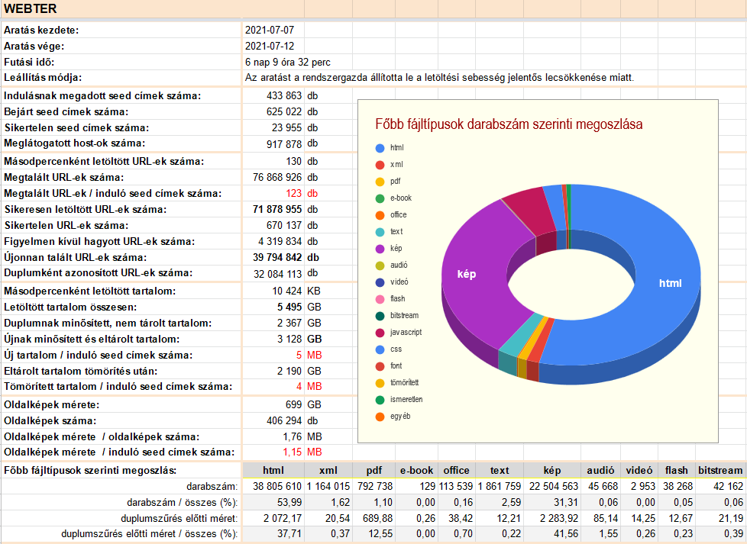
Non-public web archive:
web space (446K seeds) semi-annually
thematic (45K seeds) quarterly
e-periodicals (5560 seeds) quarterly
news portals (18 sites) daily
social media (Facebook, Instagram, Twitter) irregularly
event-based (12 events) on occasion
in total: cca 70 TB, 1 billion URLs
7

Slide 8
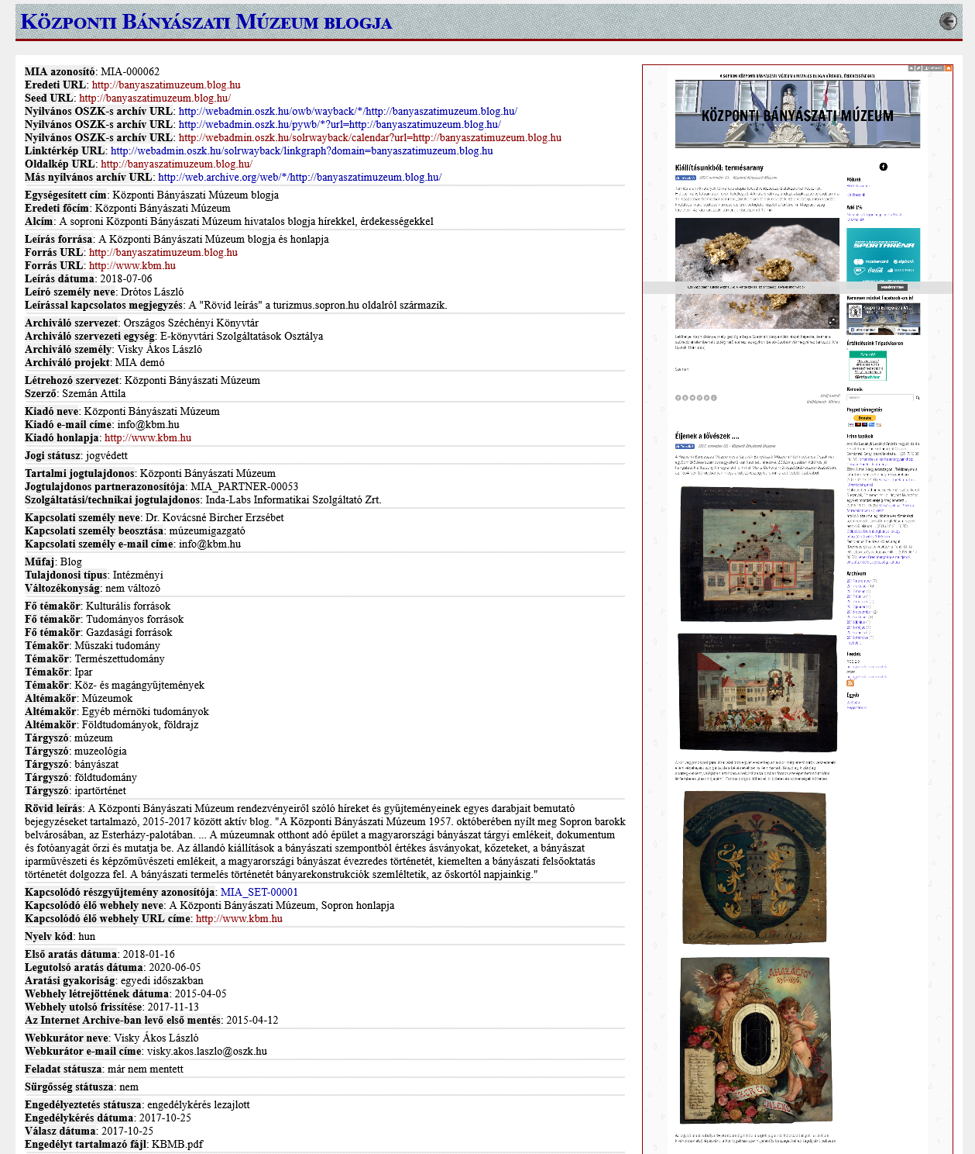
Metadata:
in-house developed scheme
based on the OCLC Web Archiving Metadata Working Group recommendations
sub-collection level records
web site level records (only in the public archive)
144 datafields (descriptive, administrative, technical)
XML format
RDA-based scheme (under developement)
8

Slide 9
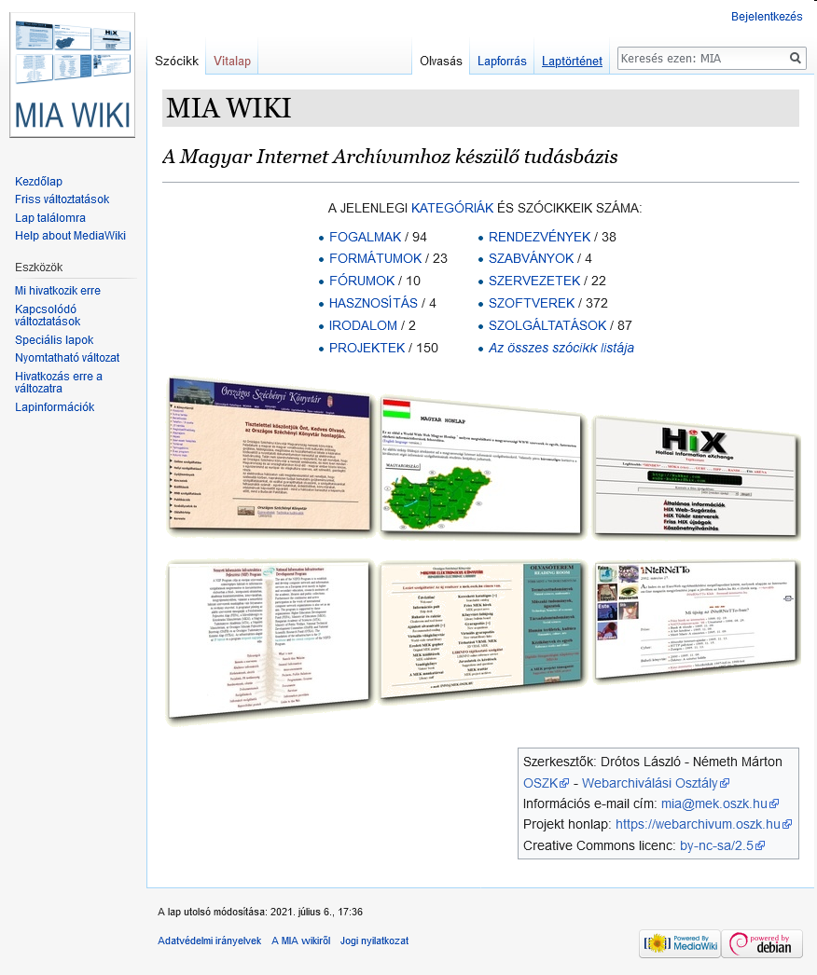
Dissemination of knowledge:
publications, presentations and demonstrations
on-line and on-site courses
web archiving wiki (~700 entry) and bibliography (~700 item)
recommendations for robot- and archive-friendly sites
MIA-L mailing list and monthly newsletter
“404 Not Found” workshops
9

Slide 10
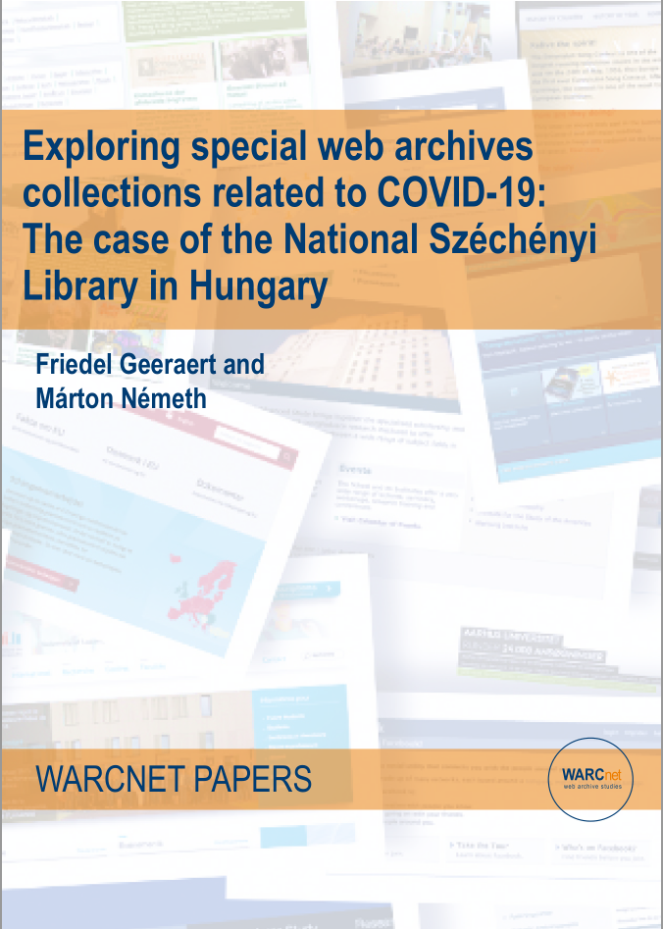
Collaborations, partnerships:
county libraries (virtual regional collections are under development)
university departments
digital humanities centers
Royal Danish Library (SolrWayback development)
IIPC Training Working Group
WARCNet Project
Internet Archive (.hu domain full text search and seed list)
10

Slide 11
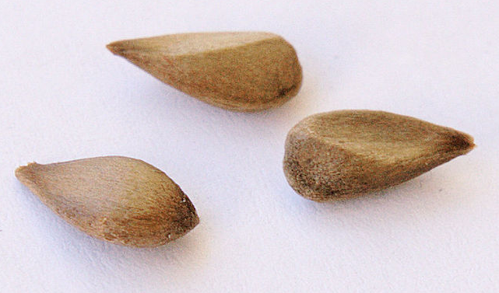
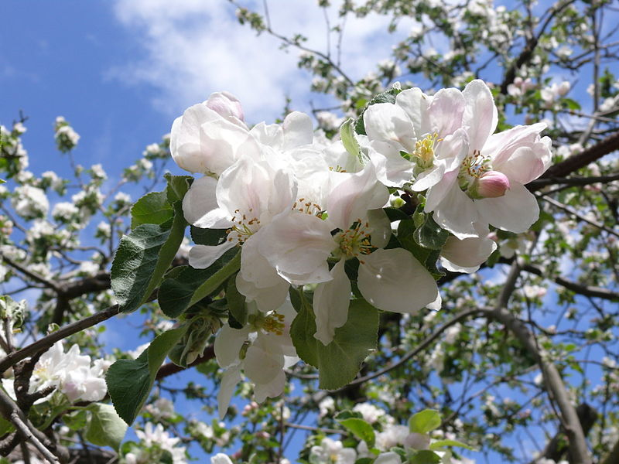
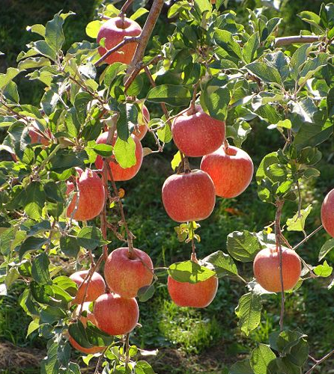
From seed to blossom:
raising awareness
IT infrastructure and expertise
legal framework
From blossom to fruit:
providing access to the non-public collection
services and datasets for scientific research
division of human labor intensive tasks between partners
11

Slide 12
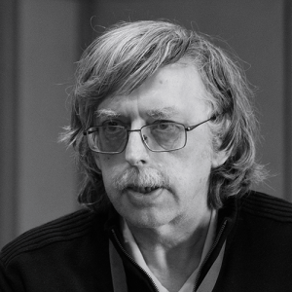
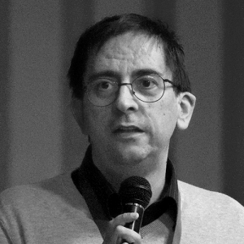
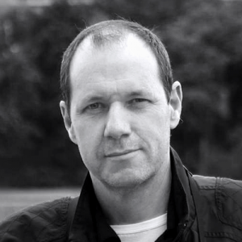
Thank you for your attention on behalf of my colleagues as well!
László (topic leader)
Márton (web librarian)
Ákos (web curator)
contact: mia@mek.oszk.hu
Gábor (IT specialist)
12

