Slide 1


England and the Catholic Reformation: the peripheries strike back
James E. Kelly
Durham University

Slide 2
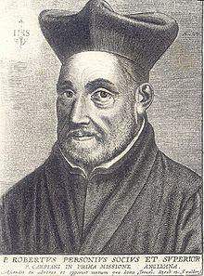
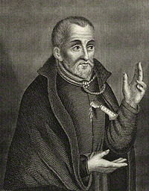
Robert Persons, SJ
Edmund Campion, SJ

Slide 3
Robert Southwell, SJ, A Short Rule of Good Life. To direct the devout Christian in a reguler and orderly course. Newly set forth according to the Authours direction before his death. Bound with An Epistle of a Religious Priest unto his father: exhorting him to the perfect forsaking of the world. Secret Press, 1596/1597. Ushaw, IV.B.12.18

Slide 4
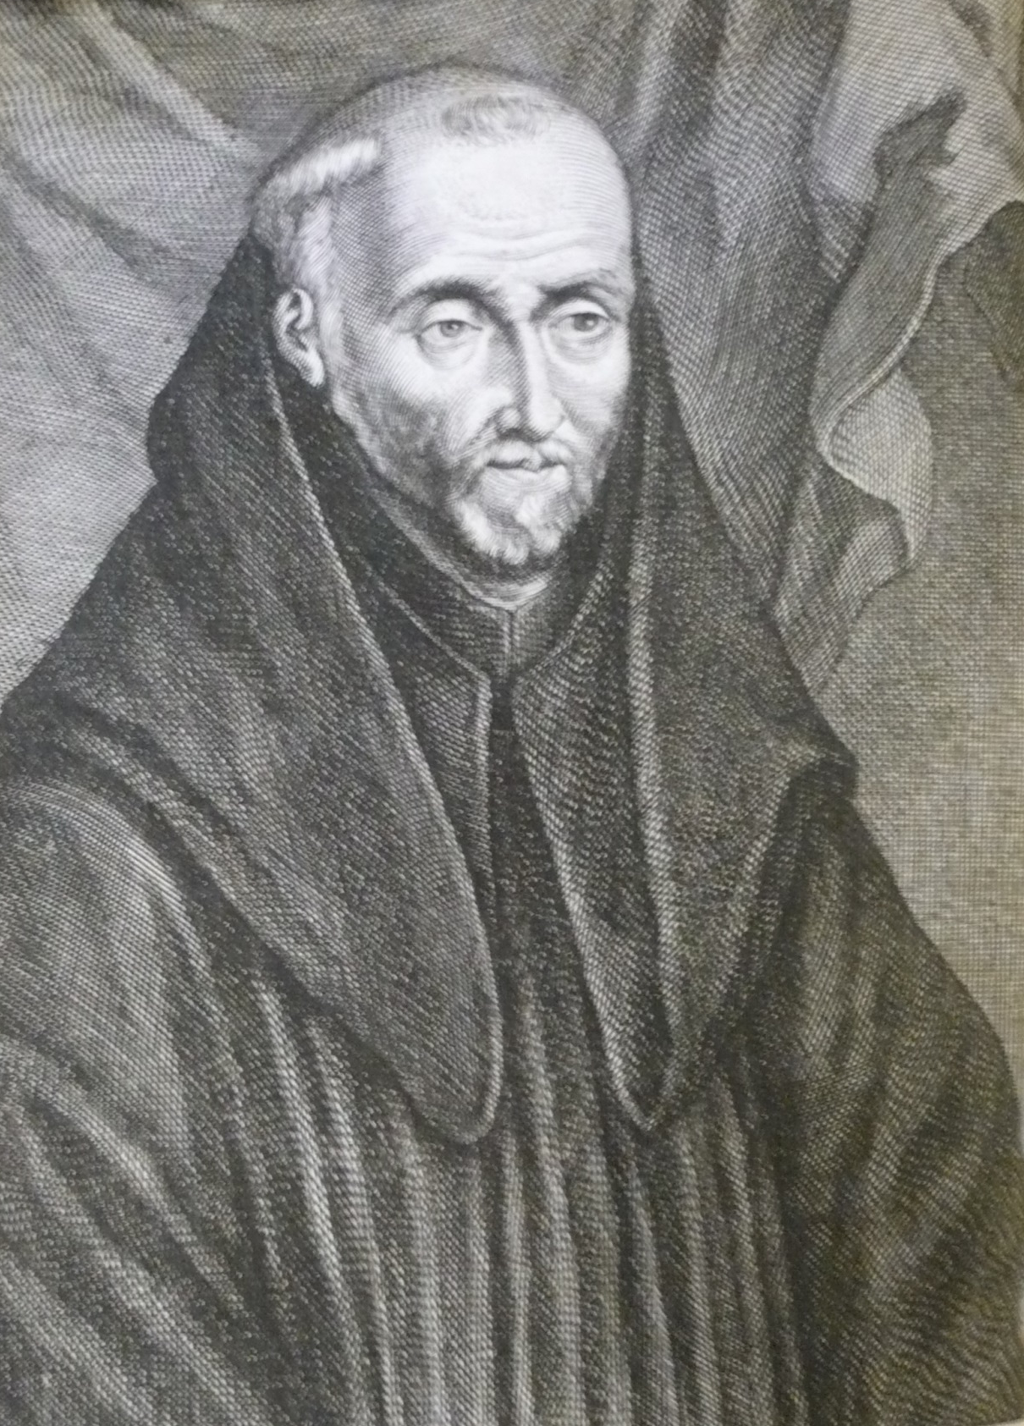
Augustine Baker, OSB

Slide 5
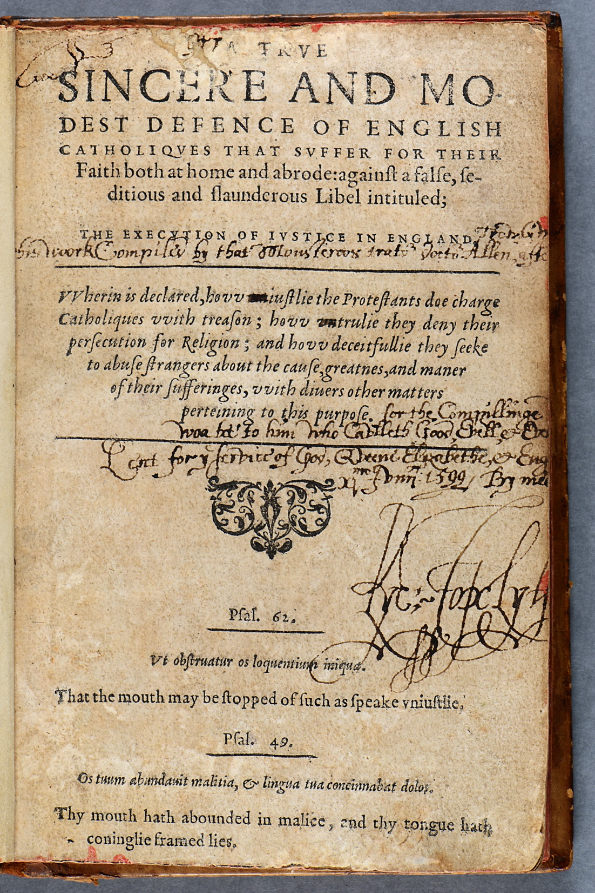
William Allen, A True, sincere and modest defence of English Catholics ….
Rouen, 1584. Ushaw, XVIII.F.2.20
Nicholas Sander, De origine ac progressu schismatis Anglicani. Cologne [false imprint], 1585. Ushaw, XVIII.G.7.16

Slide 6
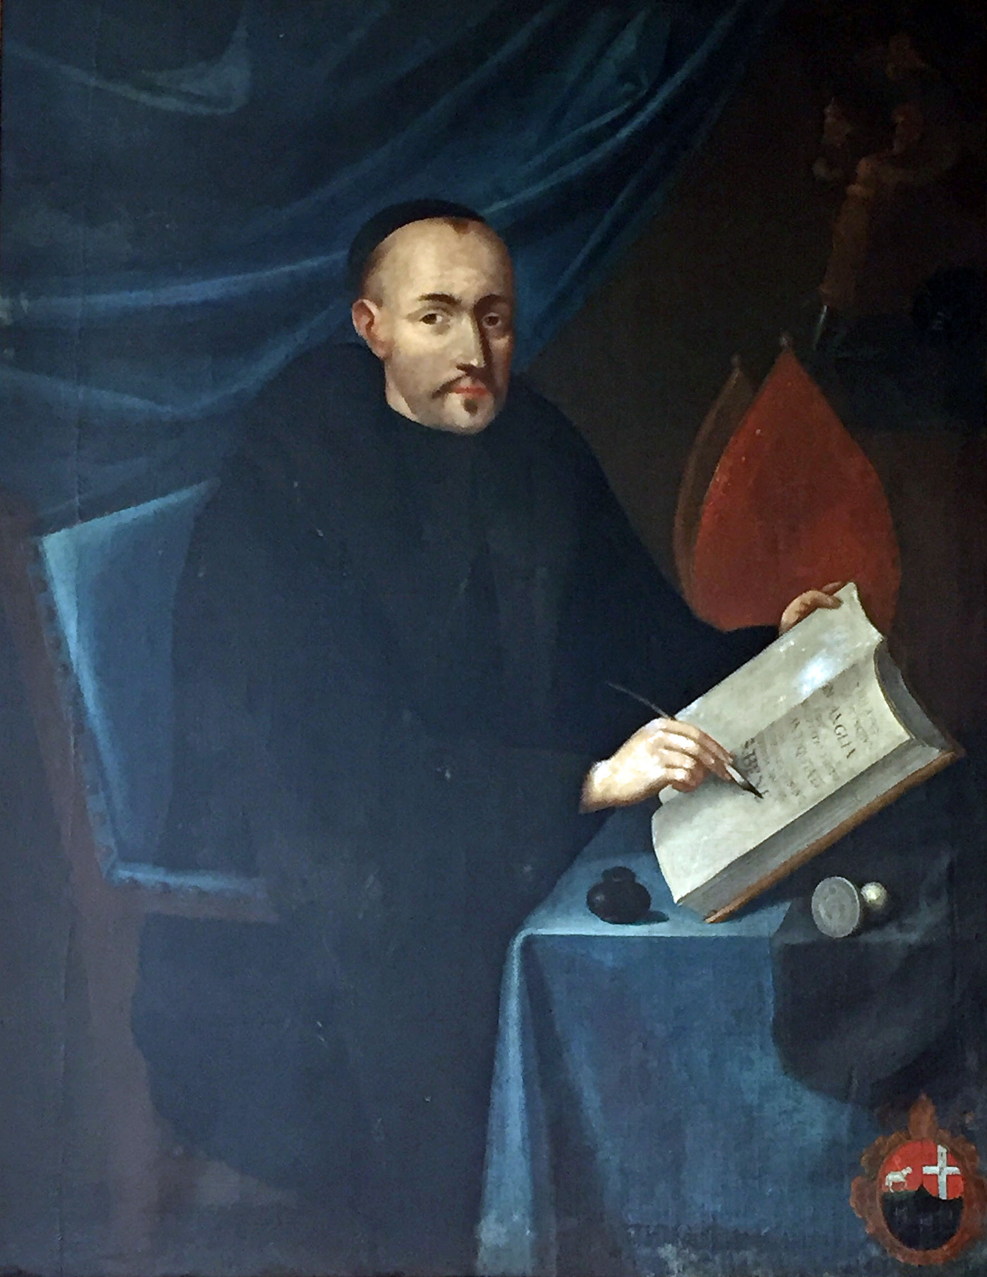
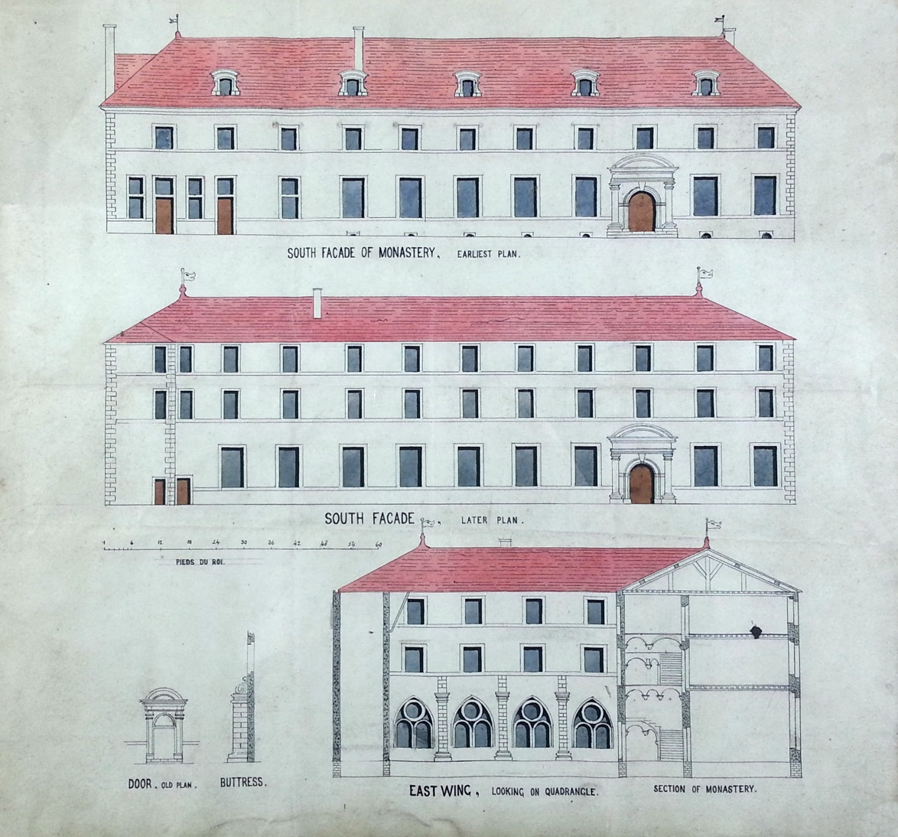
Clement Reyner, OSB
St Laurence’s, Dieulouard

Slide 7
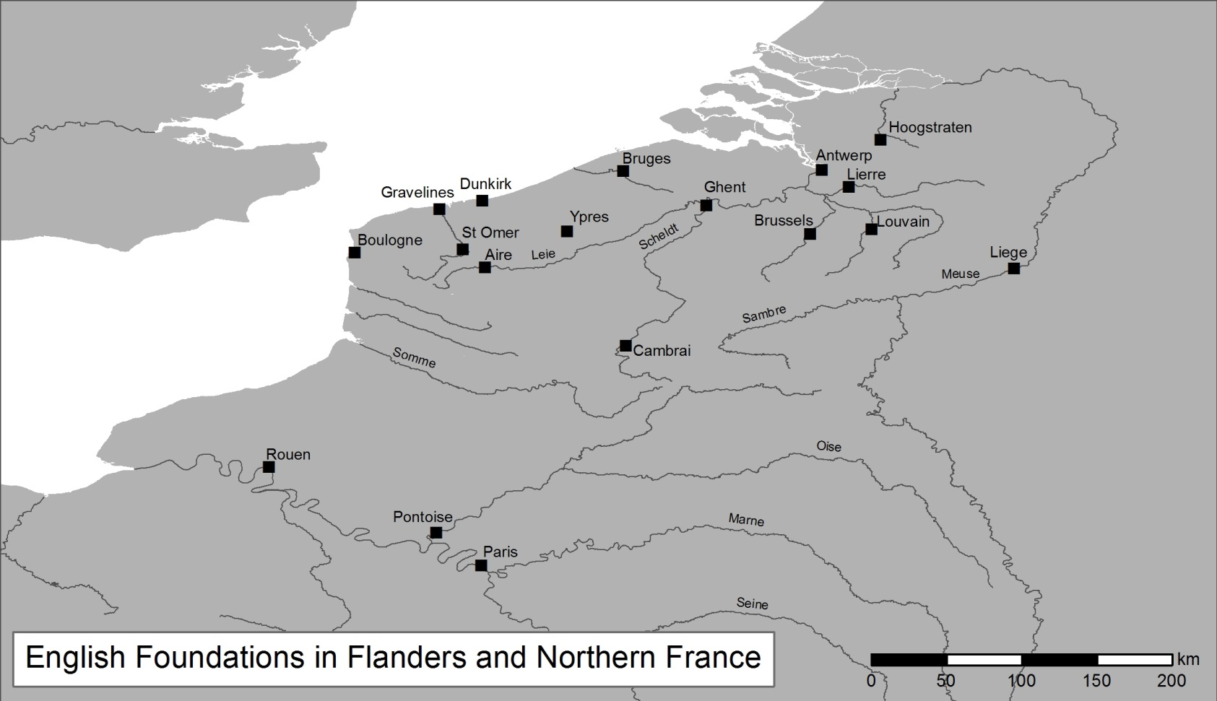
Locations of English convents in exile

