Slide 1
A Decade of Webarchiving in Austria Experiences and Challenges
Michaela Mayr MSc Austrian National Library
webarchiv@onb.ac.at https://webarchiv.onb.ac.at

Slide 2
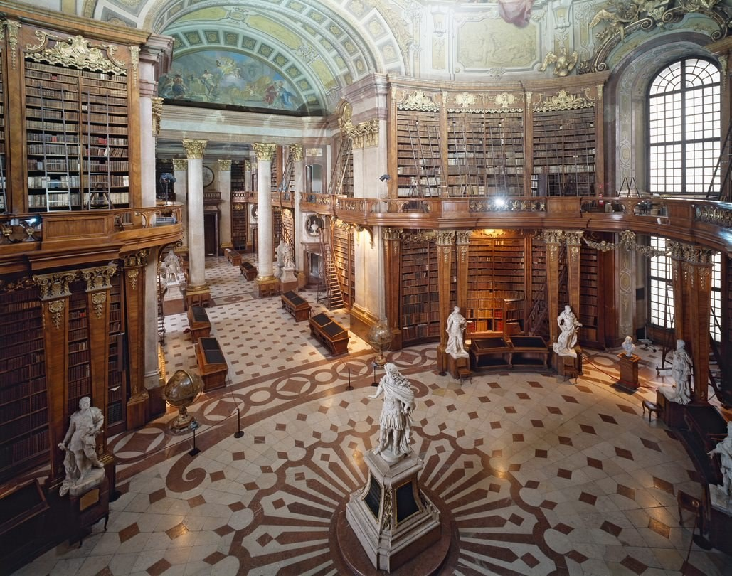
Austrian National Library
Facts & Figures
Foundation 1386
11 mio objects
Staff 300 FTE
900.000 visitors per year in reading rooms and museums (before COVID)

Slide 3
„we open rooms“
https://www.onb.ac.at/ueber-uns/vision-strategie

Slide 4
Webarchive Austria
Facts & Figures
Started 2009 based on Austrian Media Act
Domains crawls, password-protected sites
Access on library premises, approx. 20 libraries in Austria
No electronic processing, printing allowed
Resources/Infrastructure:
1 FTE, Digital Library
Hardware and storage on site
NetarchiveSuite (with Denmark, France, Spain, Sweden)

Slide 5
Webarchive Austria
Facts & Figures
188 TB
2.459.583 domains
4.371.324.936 objects

Slide 6
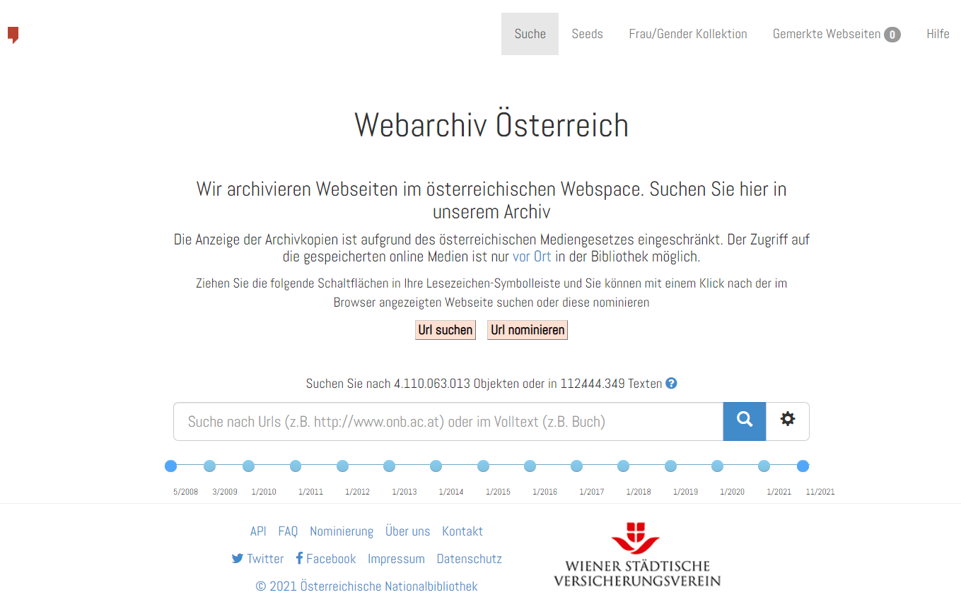
Webarchive Austria
Facts & Figures
https://webarchiv.onb.ac.at/
1 domain crawl per year
188 TB
2.459.583 domains
4.371.324.936 objects

Slide 7
Webarchive Austria
Experiences
Communication is crucial
Access is highly restricted → very few users
How can we reach out to users?
How can we stay relevant?
Management also needs to be convinced
Find internal and external supporters

Slide 8
Webarchive Austria
Experiences
Is the webarchive an island?
Workflows and infrastructure differ from the rest of the library
Sometimes not well-known internally → raise awareness and train library staff
Webarchive needs to be embedded in traditional library processes
Engage with topic specialists and find web curators

Slide 9
Webarchive Austria
Experiences
Collaboration is fruitful, but …
We need to cooperate and share experiences and tools, because we all have limited resources
It’s not always easy!
You need to invest time end energy.
We have different circumstances.
We have different priorities and roadmaps.

Slide 10
Webarchive Austria
Challenges
Researchers’ engagement
Out-of-the-box-services often not useful, individual support needed
Data in silos (e.g. websites, historical newspapers or books (OCR), eBooks, historical or recent images etc.) → prevents broader analysis
Legal restrictions (use on-site, working conditions not appropriate)

Slide 11
Webarchive Austria
Challenges
Law-making processes
Integration of recent developments in the legal frameworks (e.g. new media formats, technical developments etc.)
Concept of webpage changed over time, sometimes distinction between media types not always clear (e.g. what is an eBook?)
Austria: 5 years and counting, include eBooks and direct access for Austrian Academy of Sciences

Slide 12
Webarchive Austria
Challenges
Resources and expertise
Understaffing makes it difficult to stay up-to-date in all aspects of webarchiving
More paywalls emerging → individual handling required
Digital preservation of web materials (currently underway in Austria)

Slide 13
Thank you Any questions?
Michaela Mayr MSc Austrian National Library
webarchiv@onb.ac.at https://webarchiv.onb.ac.at

